Slide 1
Diet Control system

Slide 2
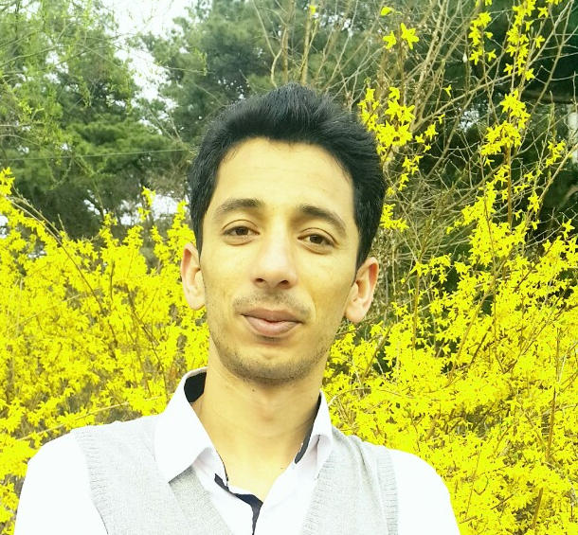
Team Members
Kamran Javed
Team Manager
2016712418
Waseem Abbas
Da-Jin Lee
Design UI
2017710282
n
Hyung-Min Jeon
Report Writer
20177110680

Slide 3
Problem Statement
Diseases related to nutrition are now a major hazard to human health.
The major challenges to constitute medical care.
Auto-Dietary portable system:
Monitor the daily food intake of a person.
Recognize and classify different food.

Slide 4
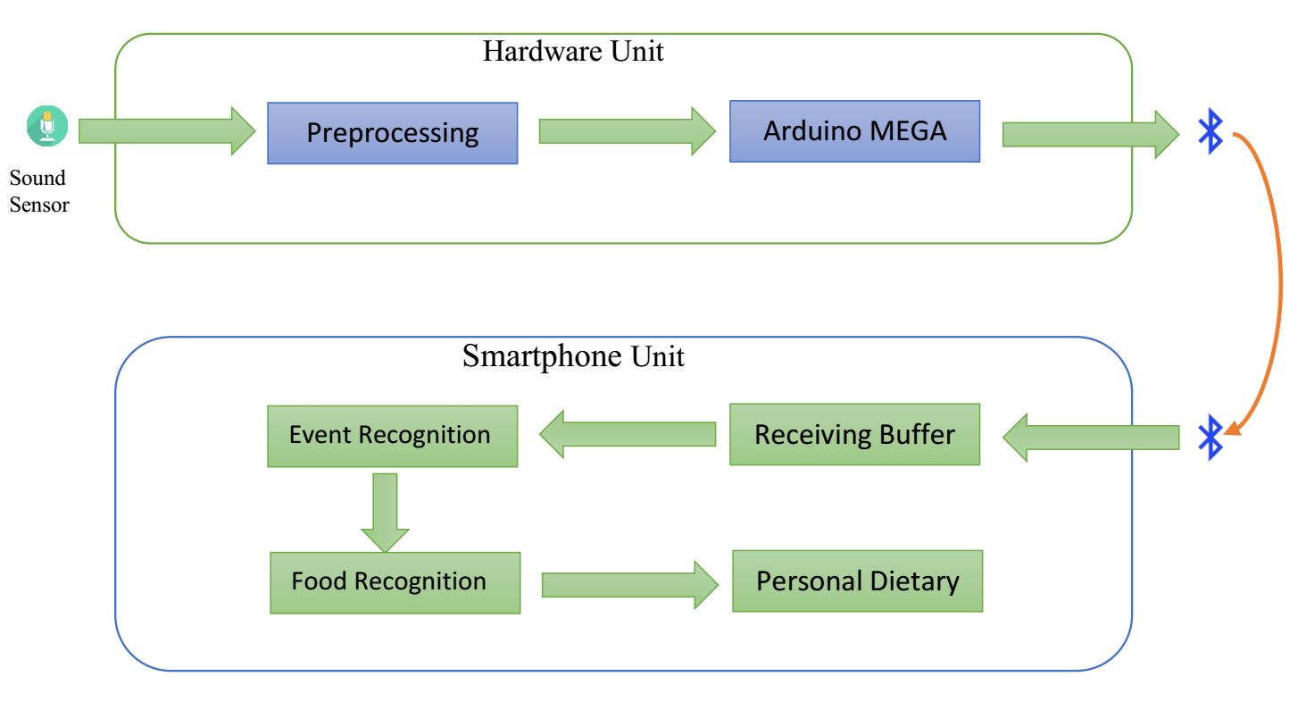
System Architecture

Slide 5
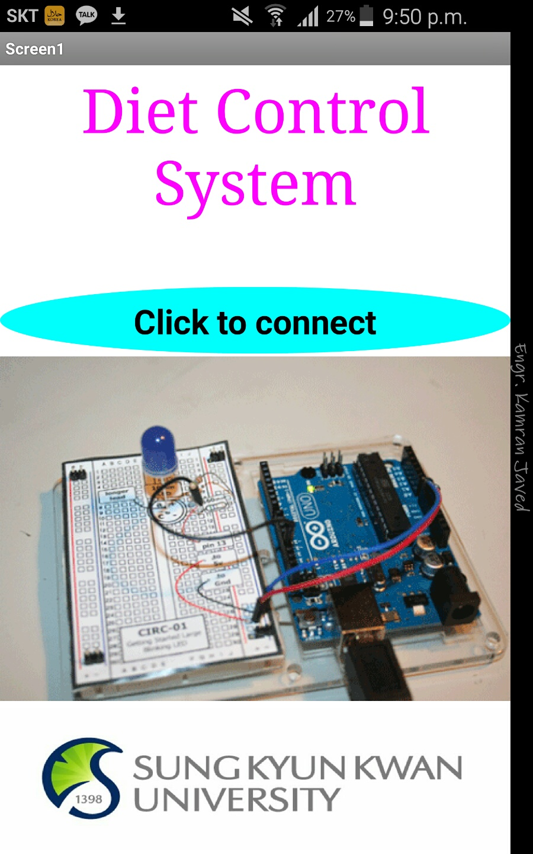
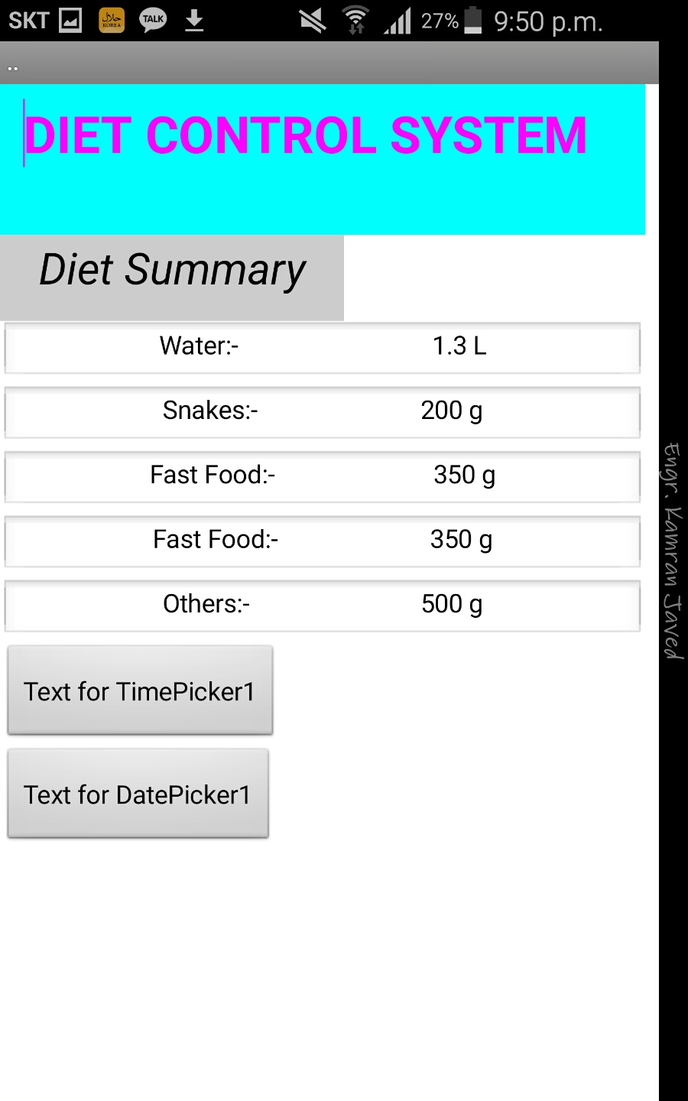
User Interface of DCS App.

Slide 6
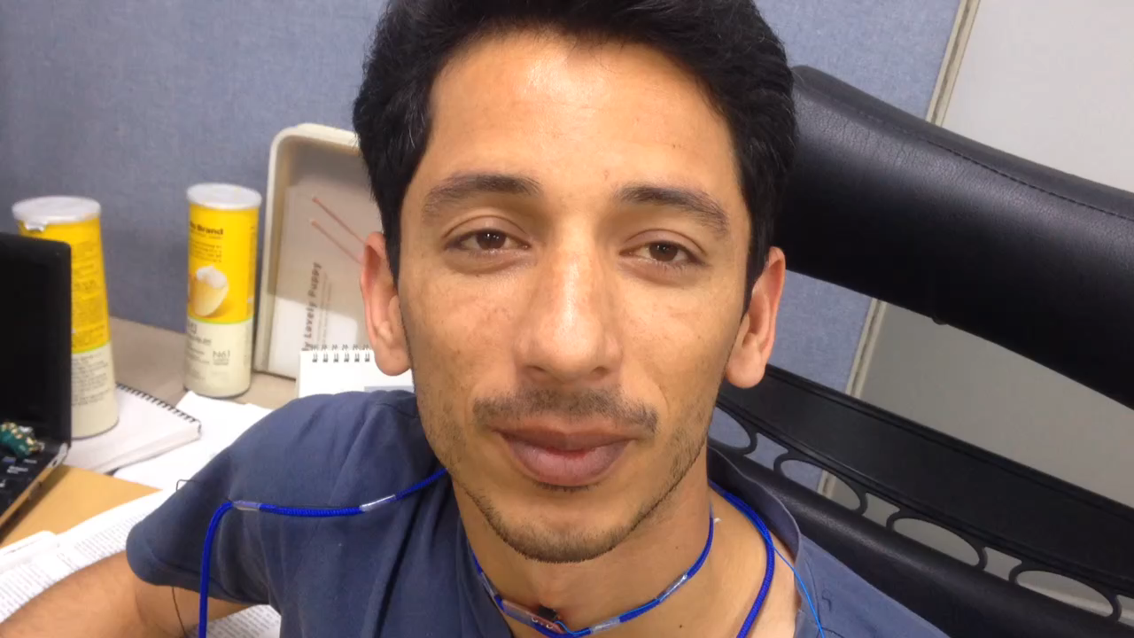
Demo…

